Slide 1
Cloud Computing Performance Testing
Evaluation of Virtual Machines and Containers
Presented by : Ahmed Tarek

Slide 2
Table of contents
01
02
03
Introduction
Environment Setup
Performance Testing Methodology
05
05
06
Results & Analysis
Conclusion
Problems Faced and Solutions

Slide 3
01
Introduction

Slide 4
What we ‘ll cover
Objective: Compare performance between Virtual Machines and Docker containers
Metrics Evaluated:
CPU Performance
Memory Performance
Disk I/O Performance
Network Performance
HPC (High-Performance Computing) Capabilities
Environment: 3-node cluster (Master, Node01, Node02) for VMs and three containers

Slide 5
02
Environment Setup

Slide 6

Environment Setup - VMs
VM Specifications:
Ubuntu 24.04 LTS
2 CPUs, 2GB RAM, 30GB storage per VM
Internal network with static Ips
Master: 192.168.56.1
Node01: 192.168.56.2
Node02: 192.168.56.3
SSH Access: Port forwarding enabled
master: Host IP 127.0.0.1 -> Port 3022 → Guest Port 22
node01: Host IP 127.0.0.1 -> Port 4022 → Guest Port 22
node02: Host IP 127.0.0.1 -> Port 5022 → Guest Port 22

Slide 7

Environment Setup - Containers
Container Specifications:
2 CPUs, 2GB RAM per container
Docker bridge network
Containers: Master, Node01, Node02

Slide 8
03
Performance Testing Methodology

Slide 9
Tools Used & Testing Approach
Tools Used:
CPU: stress-ng, HPC Challenge (HPCC)
Memory: sysbench, STREAM benchmark
Disk I/O: IOZone
Network: iperf
HPC: HPC Challenge benchmark suite
Testing Approach:
Identical parameters across both environments
Multiple test runs for consistency
Comprehensive metrics collection

Slide 10
CPU Performance Results
stress-ng Results:
HPC Challenge (HPCC) Results:
Environment | Completion Time (sec) | Bogo Ops | Bogo Ops/s (real time)
VM | 60.64 | 10642 | 175.5
Container | 60.42 | 10782 | 178.48
Difference | 0.36% faster in containers | 1.32% more | 1.68% better in containers
Environment | Performance (GFLOPS)
VM | 10.25
Container | 10.85
Difference | 5.85% better in containers
Notes:
GFLOPS (Giga Floating-Point Operations Per Second) is a unit of measure for a computer's computational speed, indicating the number of billion floating-point operations it can perform in one second.

Slide 11
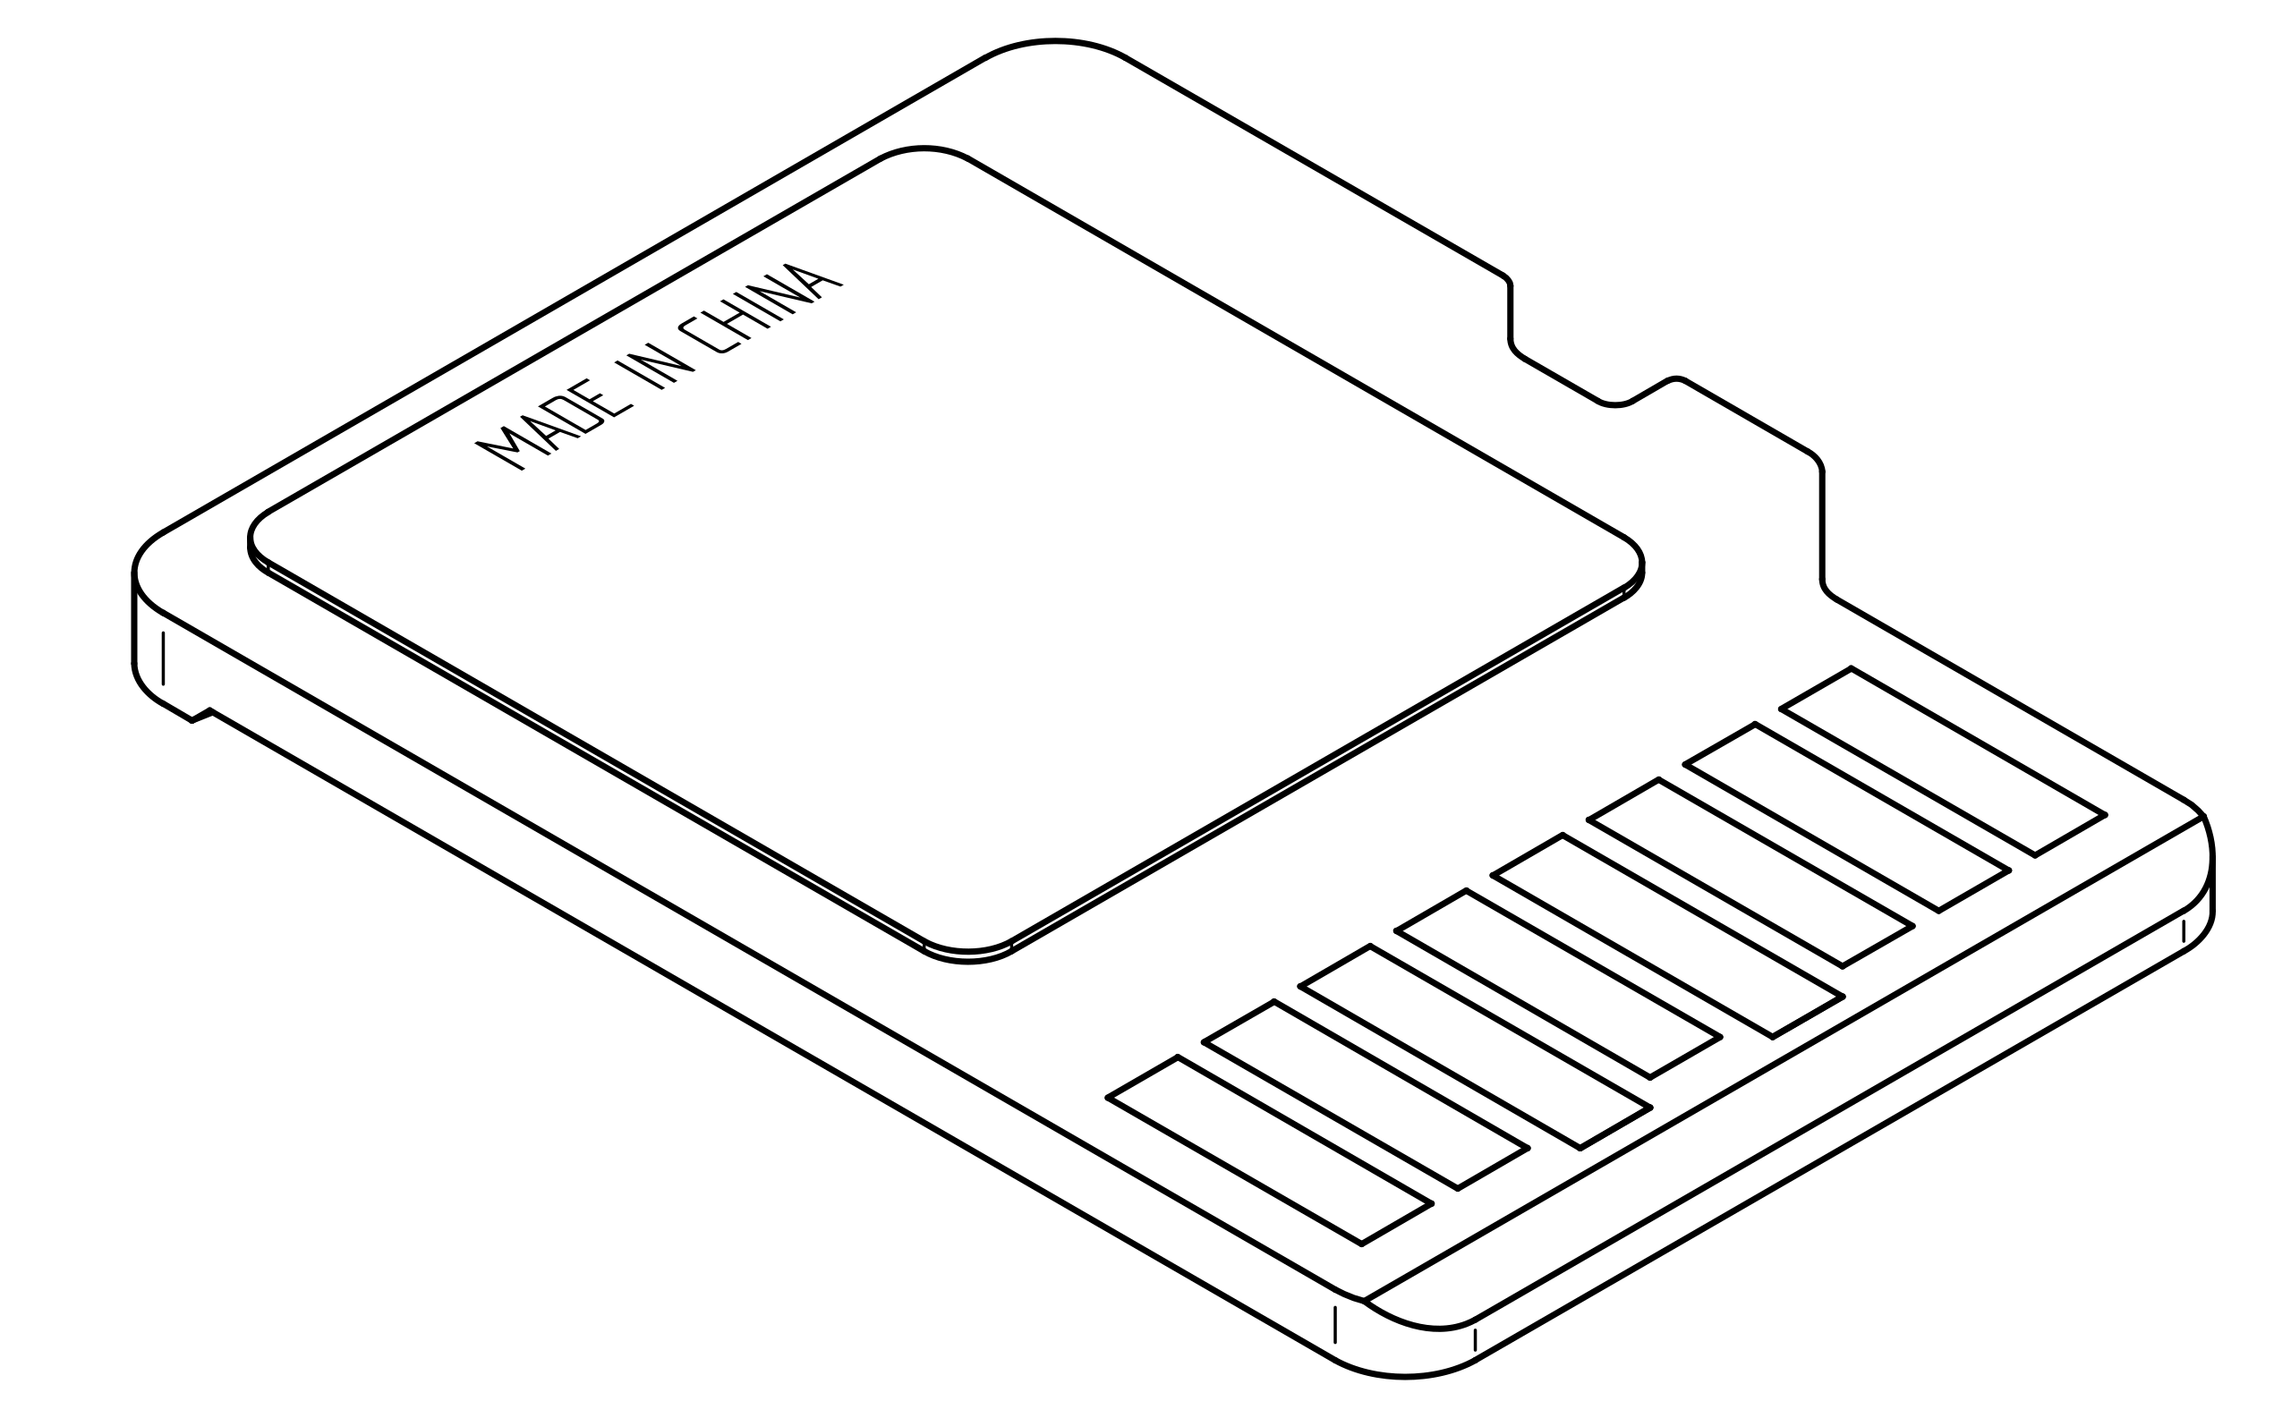
Memory Performance Results
sysbench Results:
VM: 4400.22 MiB/sec
Container: 4460.73 MiB/sec
Containers better by 1.37%
STREAM Benchmark (from HPCC):
Operations | VM (MB/s) | Container (MB/s) | Difference
Copy | 5420.32 | 5620.45 | +3.69%
Scale | 5380.15 | 5580.32 | +3.72%
Add | 5890.45 | 6120.18 | +3.90%
Triad | 5910.23 | 6150.42 | +4.06%

Slide 12
Disk I/O Performance Results
IOZone Results (64KB record size, 65536KB file size):
Operations | VM (KB/s) | Container (KB/s) | Difference
Write | 1047266 | 1152993 | +10.09%
Read | 6215468 | 6836015 | +9.98%
Random Read | 5013476 | 5514824 | +10.00%
Random Write | 2878821 | 3166703 | +9.99%
Key Finding: Disk I/O shows the largest performance gap (~10%)

Slide 13

Network Performance Results
iperf Results:
VM: 903 Mbits/sec
Container: 942 Mbits/sec
Containers better by 4.32%

Slide 14
HPC Performance Results
HPCC Benchmark Suite:
Benchmark | VM | Container | Difference
HPL | 10.25 GFLOPS | 10.85 GFLOPS | + 5.85%
RandomAccess | 0.15 GUPS | 0.16 GUPS | + 6.67%
PTRANS | 1.25 GB/S | 1.32 GB/S | + 5.60%
FFT | 2.35 GFLOPS | 2.48 GFLOPS | + 5.53%
Communication Latency | 3.42 μs | 3.28 μs | - 4.09%
Notes:
HPL^{[3]} (High Performance LINPACK) – measures performance of a solver for a dense system of linear equations (global).
DGEMM – measures performance for matrix-matrix multiplication (single, star).
STREAM^{[4]} – measures sustained memory bandwidth to/from memory (single, star).
PTRANS – measures the rate at which the system can transpose a large array (global).
RandomAccess – measures the rate of 64-bit updates to randomly selected elements of a large table (single, star, global).
FFT – performs a Fast Fourier Transform on a large one-dimensional vector using the generalized Cooley–Tukey algorithm (single, star, global).
Communication Bandwidth and Latency – MPI-centric performance measurements based on the b_eff^{[5]} bandwidth/latency benchmark.

Slide 15
04
Results & Analysis

Slide 16

Performance Comparison Summary
Containers outperform VMs across all metrics:
CPU: 0.36% - 5.85% better
Memory: 1.37% - 4.06% better
Disk I/O: ~10% better
Network: 4.32% better
HPC: 3.69% - 6.67% better

Slide 17
05
Conclusion

Slide 18
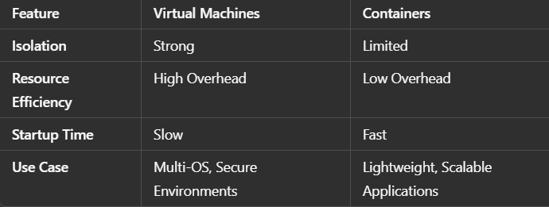
Features Comparison

Slide 19
Features Comparison
Key Findings:
Containers consistently outperform VMs across all metrics
Disk I/O shows the most significant improvement
HPC workloads benefit significantly from containers
Consider VMs When:
Strong isolation is required
Different OS kernels are needed
Regulatory compliance requires VM-level isolation
Notes:
Project provided insights into VMs vs Containers performance.
VMs offer better isolation but consume more resources.
Containers are lightweight but less isolated.
Resource allocation is key for optimizing performance

Slide 20
06
Problems Faced and Solutions

Slide 21
HPL Benchmark Failure
During the execution of HPL, several configuration issues were encountered in the HPL.dat file, leading to multiple errors. Below are the errors and their respective solutions:

Slide 22
SSH Access to VMs
After setting port forwarding the SSH to access my vms via ssh wasn’t working, this material helped me to install , update some packages to solve this problem
Hostname Configuration
Problem: After cloning the VMs, the hostnames were not correctly configured.
Solution: I followed the guide at How to Set Hostname on Cloned VM

Slide 23
Thanks!

